Slide 1

Health Disparities Research
Module 4
Defining & quantifying health disparities
Session 1

Slide 2
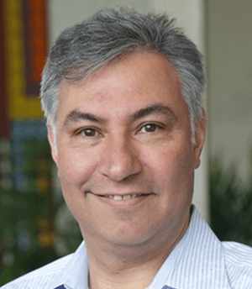


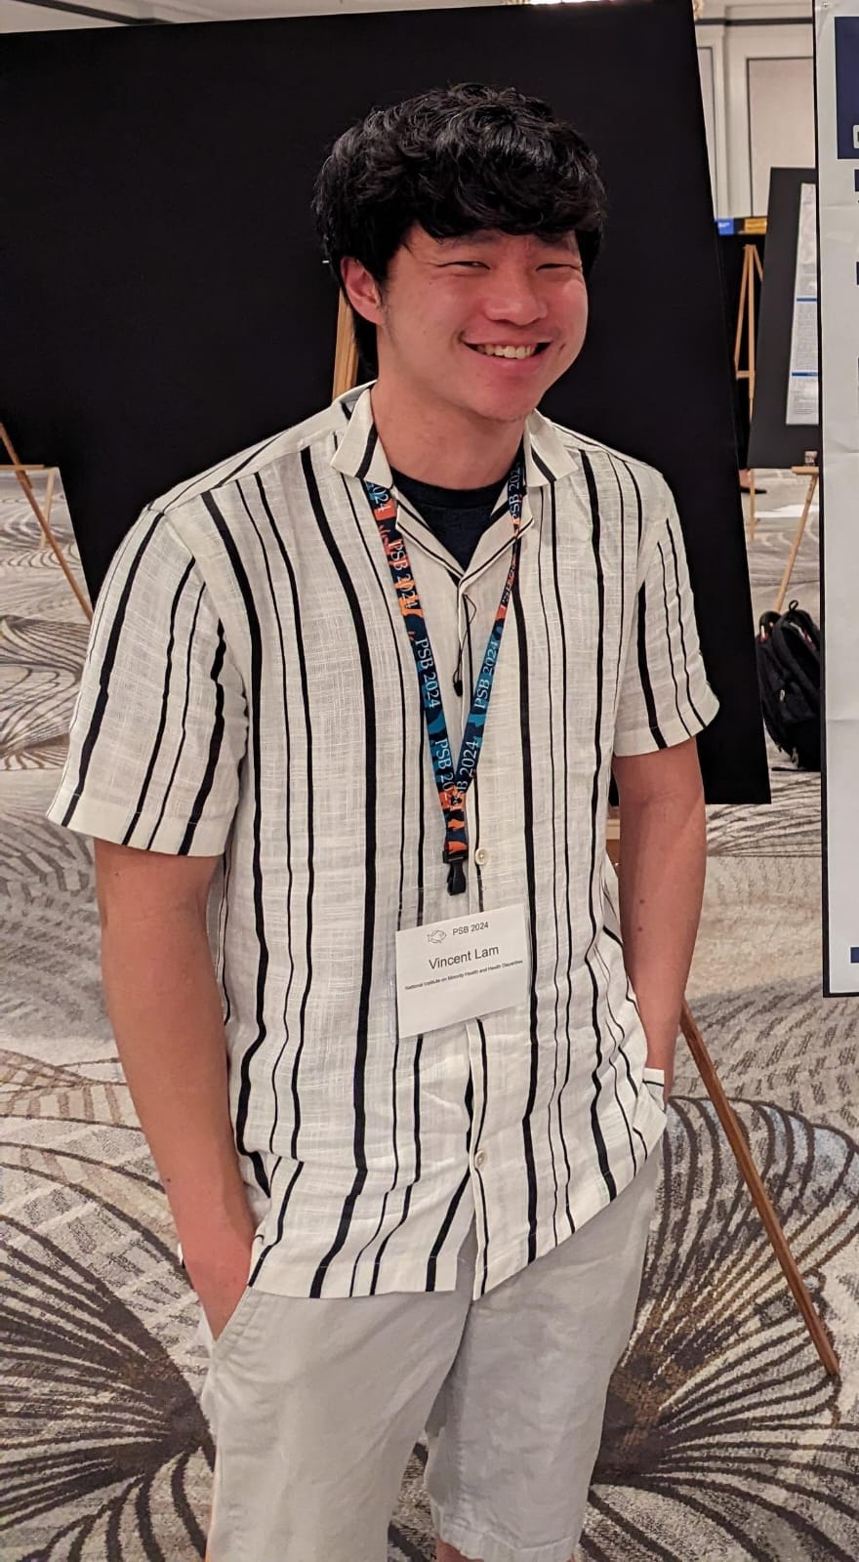


Course Instructors
Teaching Assistants
Leonardo Mariño-Ramírez
Stadtman Investigator
NIMHD | NIH
Sonali Gupta
Bioinformatics Scientist
ABiL
King Jordan
Professor
Georgia Tech
Vincent Lam
Postbaccalaureate Fellow
NIMHD | NIH
Shashwat Deepali Nagar
Computational Biologist
CRISPR Therapeutics
Shivam Sharma
PhD Student
Georgia Tech

Slide 3



With support from
https://bioinformatics.gatech.edu/
https://www.nimhd.nih.gov/
https://www.abil.ihrc.com/

Slide 4
Session 1 overview
Course overview & logistics
National Institute on Minority Health and Health Disparities (NIMHD)
Key concepts in health disparities
Population biobanks
Electronic health records
Epidemiology basics
Quantifying morbidity
Health disparities research
Examples from our own work
Ethics

Slide 5
Course overview & logistics

Slide 6
Session | Day | Time | Session Title | Instructors & TAs
1 | Wed, May 29 | 1:30-3:00 | Defining & quantifying health disparities | Leonardo & King
2 | Wed, May 29 | 3:30-5:00 | Defining & quantifying health disparities | Vincent, Shivam & Sonali
3 | Thu, May 30 | 8:30-10:00 | Health outcome modeling | Leonardo & King
4 | Thu, May 30 | 10:30-12:00 | Health outcome modeling | Shivam, Vincent & Sonali
5 | Thu, May 30 | 1:30-3:00 | Social determinants of health | Leonardo & King
6 | Thu, May 30 | 3:30-5:00 | Modeling social determinants of health | Sonali, Shivam & Vincent
7 | Fri, May 31 | 8:30-10:00 | Genetic diversity & population structure | Shashwat & King
8 | Fri, May 31 | 10:30-12:00 | Genetic diversity & population structure | Shashwat, Shivam & Sonali
9 | Fri, May 31 | 1:30-3:00 | Genetic ancestry inference and modeling | Shashwat & King
10 | Fri, May 31 | 3:30-5:00 | Genetic ancestry inference and modeling | Shashwat, Shivam & Sonali
Conceptual Lecture Sessions
Practical Computer Lab Sessions

Slide 7
Practical lab session methods and data
All data and code needed to complete exercises will be provided via course GitHub
https://github.com/healthdisparities/SISG2024-Module4
Data will be small enough so that students can complete all analyses on their laptops
Prerequisites
R, Jupyter Notebook, Bioinformatics applications
Installation instructions on GitHub
https://github.com/healthdisparities/SISG2024-Module4/blob/main/Prerequisites.md

Slide 8
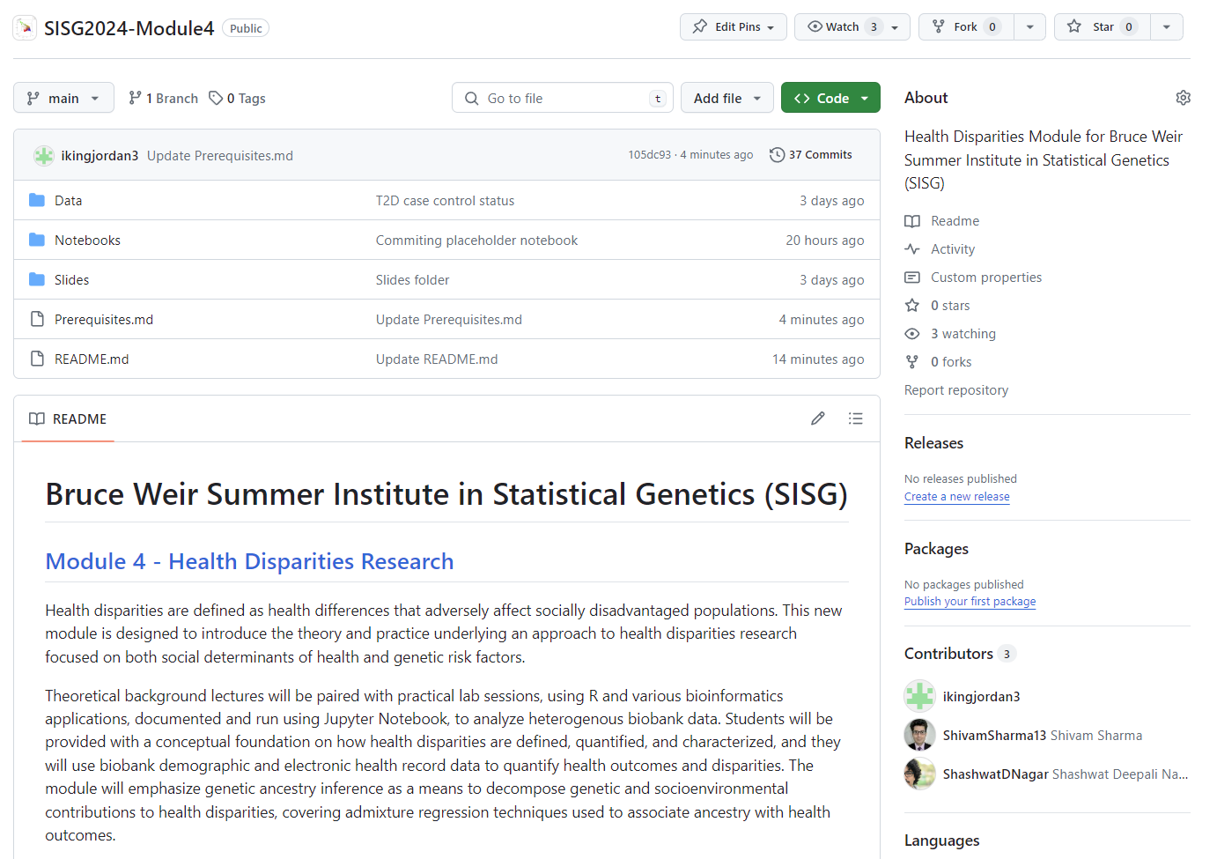
https://github.com/healthdisparities/SISG2024-Module4

Slide 9
Pedagogical model
Conceptual Lectures
Introduce key concepts in health disparities research
Reinforce with real-world examples from our own work
Practical Labs
Demonstrations and exercises for key statistical methods
Simulated demographic & health outcome data that recapitulate observed disparities
Publicly available genomic data
Stress caveats & limitations

Slide 10
Practical lab session participation modes
Demonstration – follow instructors’ demonstrations of code and methods
In-class exercise – complete analyses in real-time as instructors demonstrate code and methods
On-own exercise – follow instructors’ demonstrations of code and methods and complete analyses at a later time
** these options are not mutually exclusive

Slide 11
NIMHD

Slide 12
National Institute on Minority Health & Health Disparities (NIMHD)
Overview & mission
Key definitions
Minority Health
Health Disparities
Health Equity
NIMHD-inspired approach to the course

Slide 13
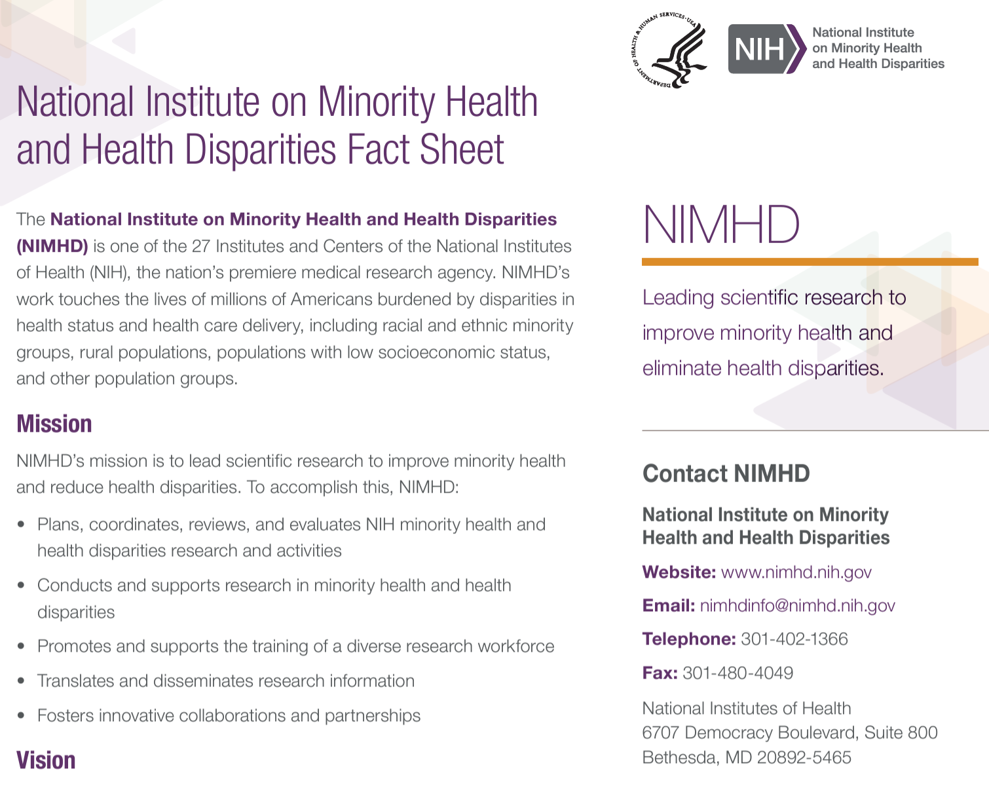
https://www.nimhd.nih.gov/
@nimhd

Slide 14
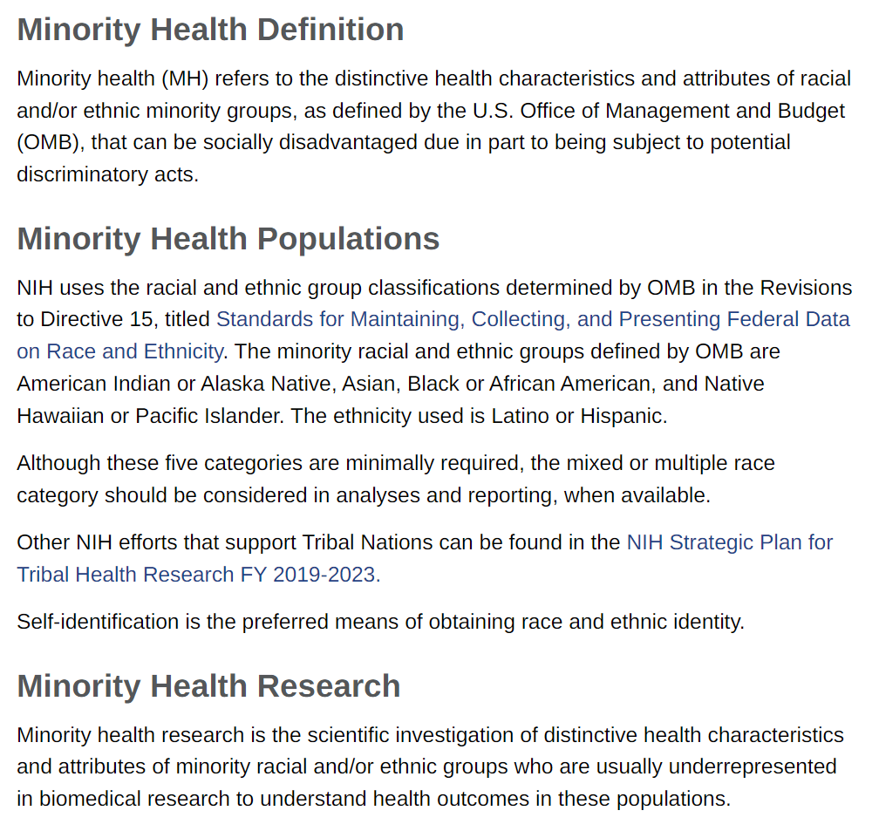
https://www.nimhd.nih.gov/about/strategic-plan/nih-strategic-plan-definitions-and-parameters.html

Slide 15
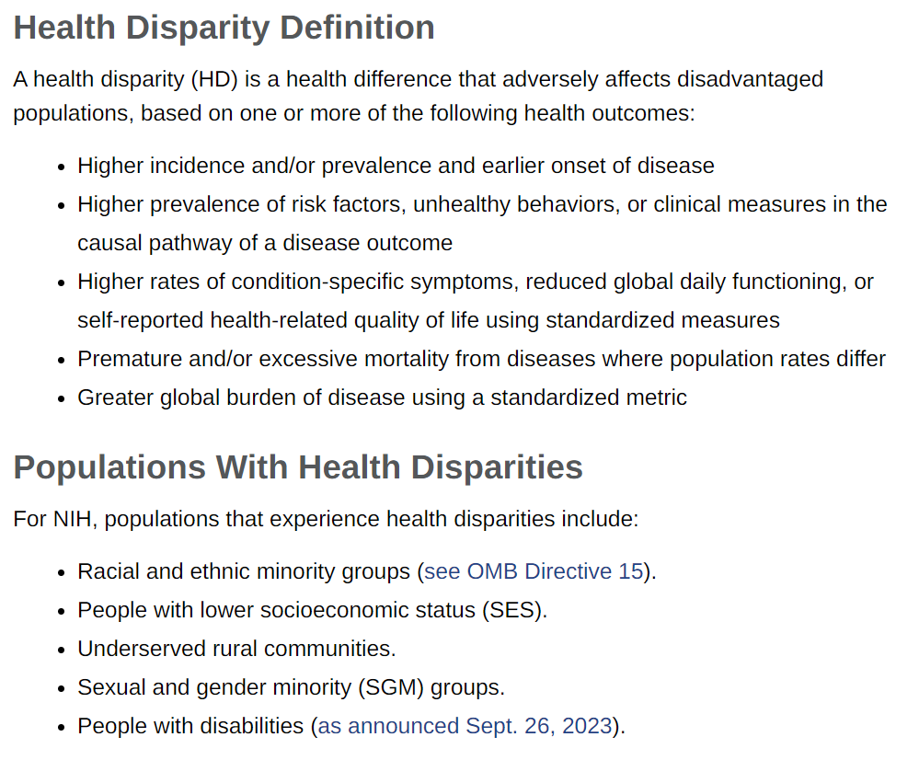
https://www.nimhd.nih.gov/about/strategic-plan/nih-strategic-plan-definitions-and-parameters.html

Slide 16
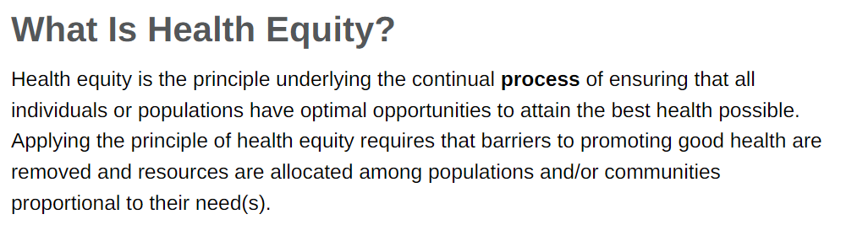
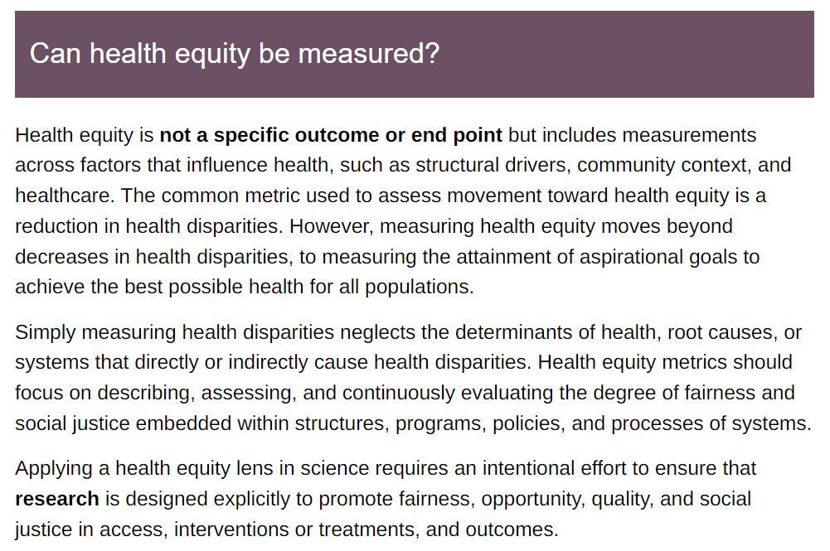
https://www.nimhd.nih.gov/resources/understanding-health-disparities/health-equity.html

Slide 17
NIMHD-inspired approach for this course
Focus on minority health
Health disparities along the axis of race & ethnicity
Observational studies of population biobanks
Integrated approach to health disparities
Social determinants of health (SDOH)
Genetic (genomic) risk factors

Slide 18
Population biobanks

Slide 19
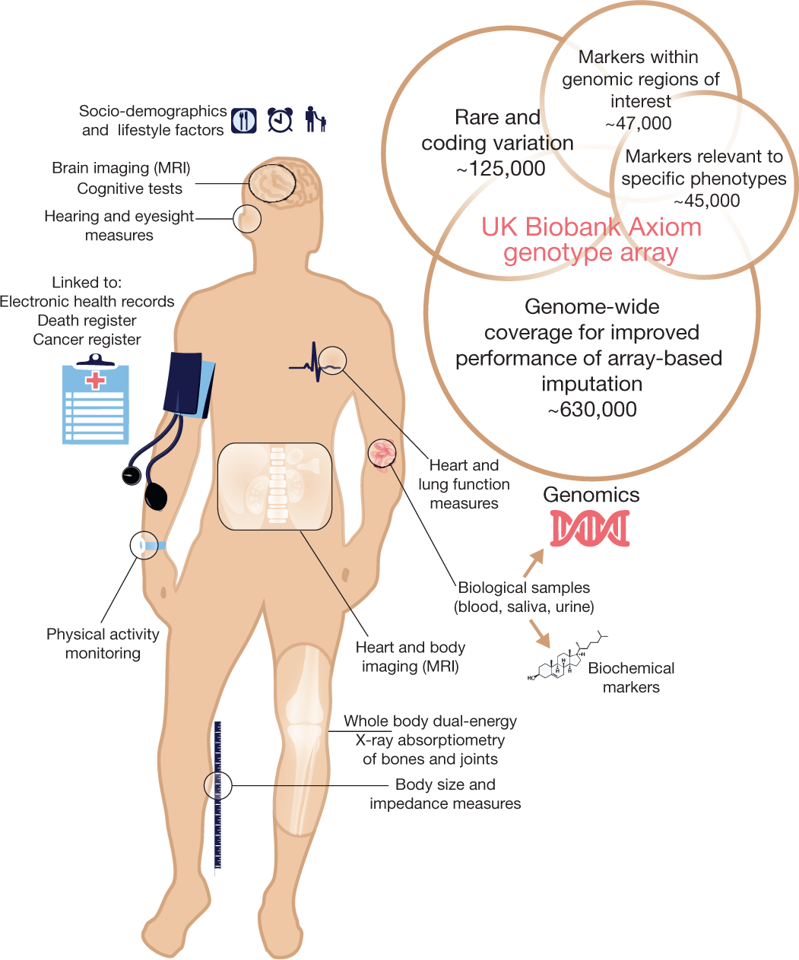


Population biobanks
Data
Genetics
Demographics
Socioeconomic status
Lifestyle & environment
Deep phenotyping
Electronic health records (EHR)
UK: 500,000
US: 1,000,000

Slide 20
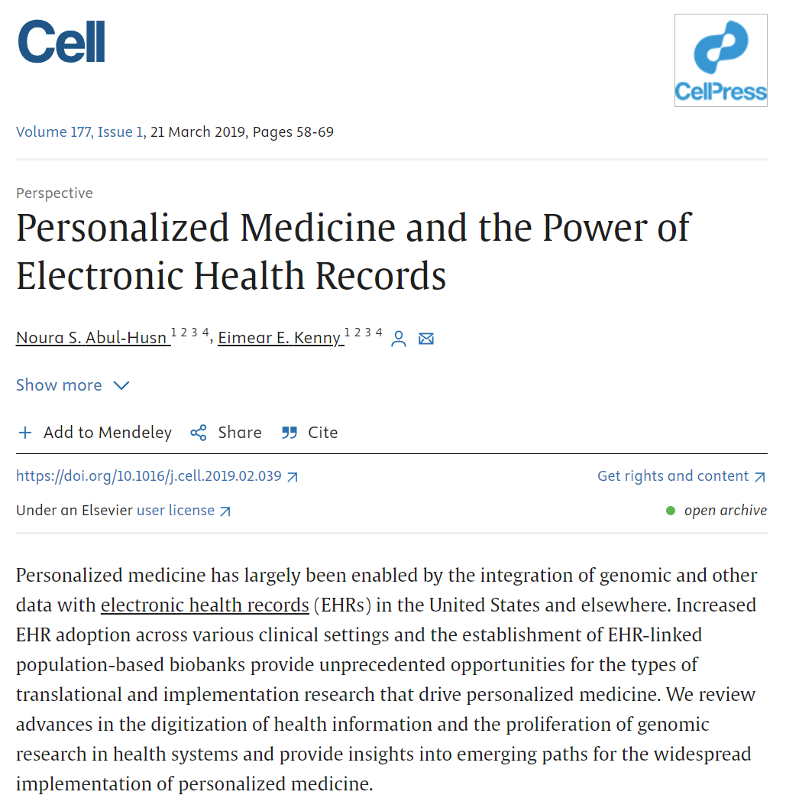
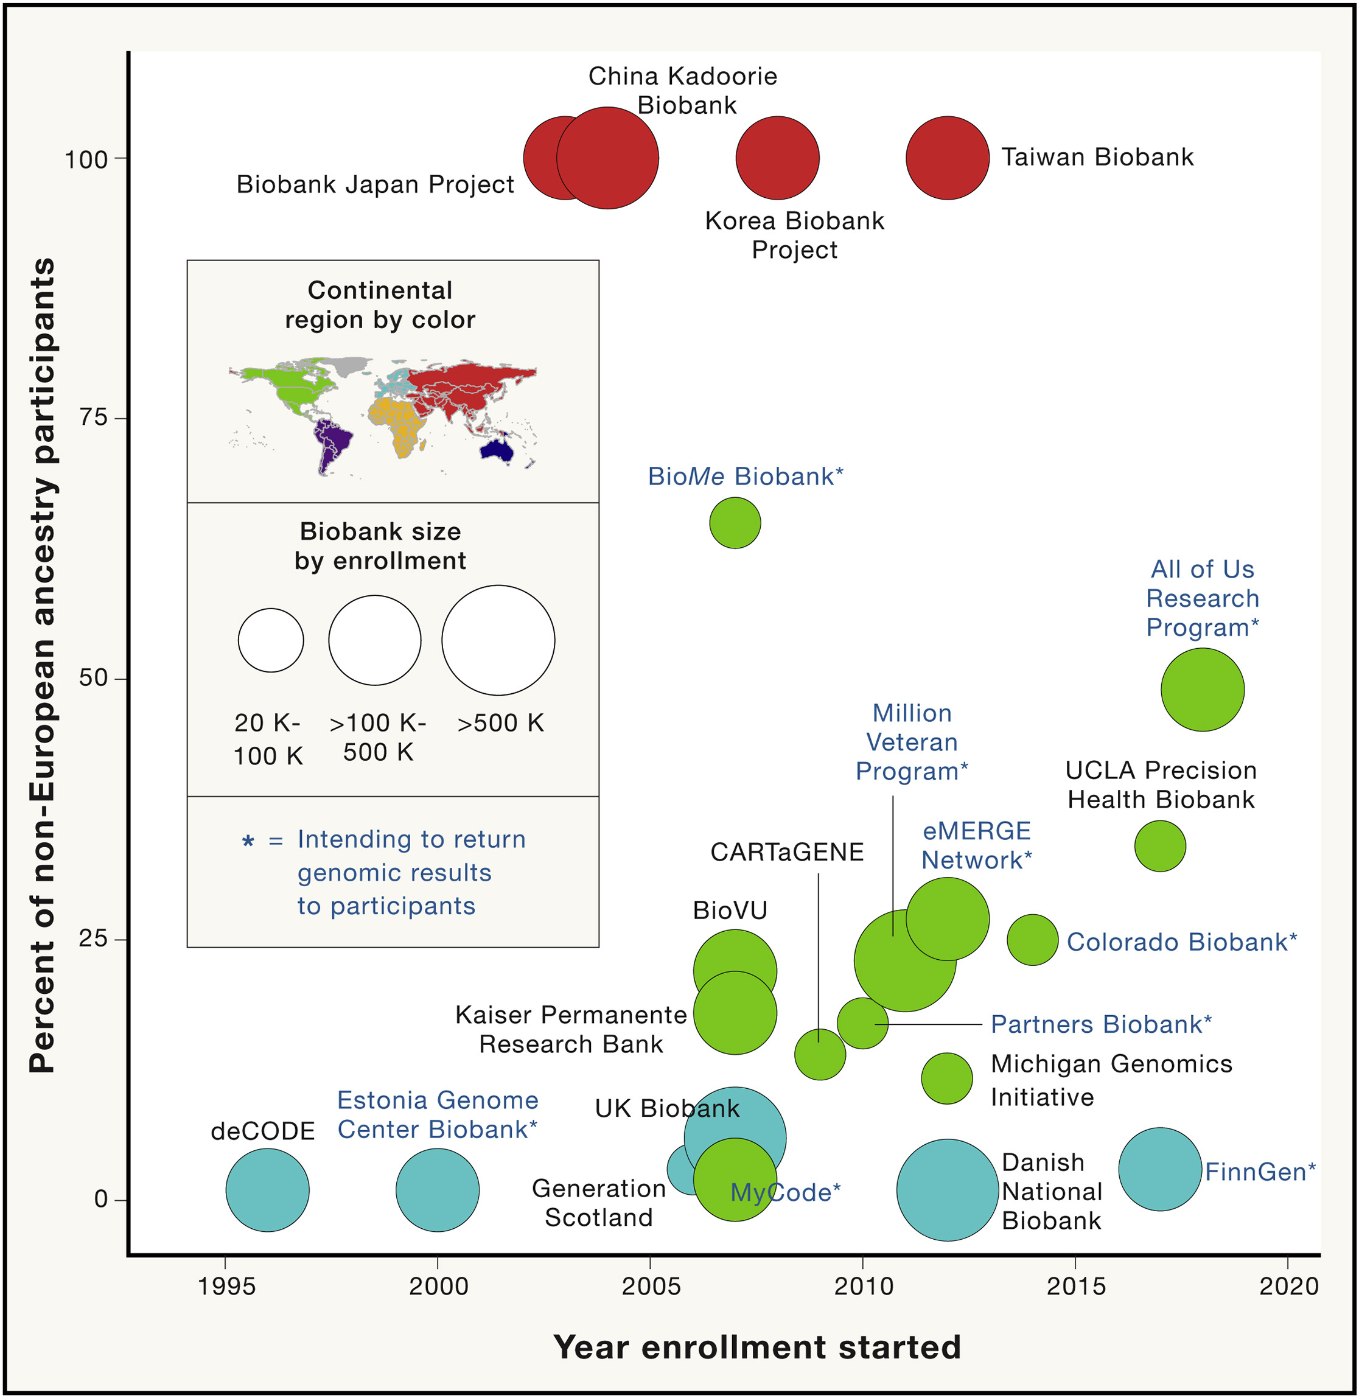

Slide 21
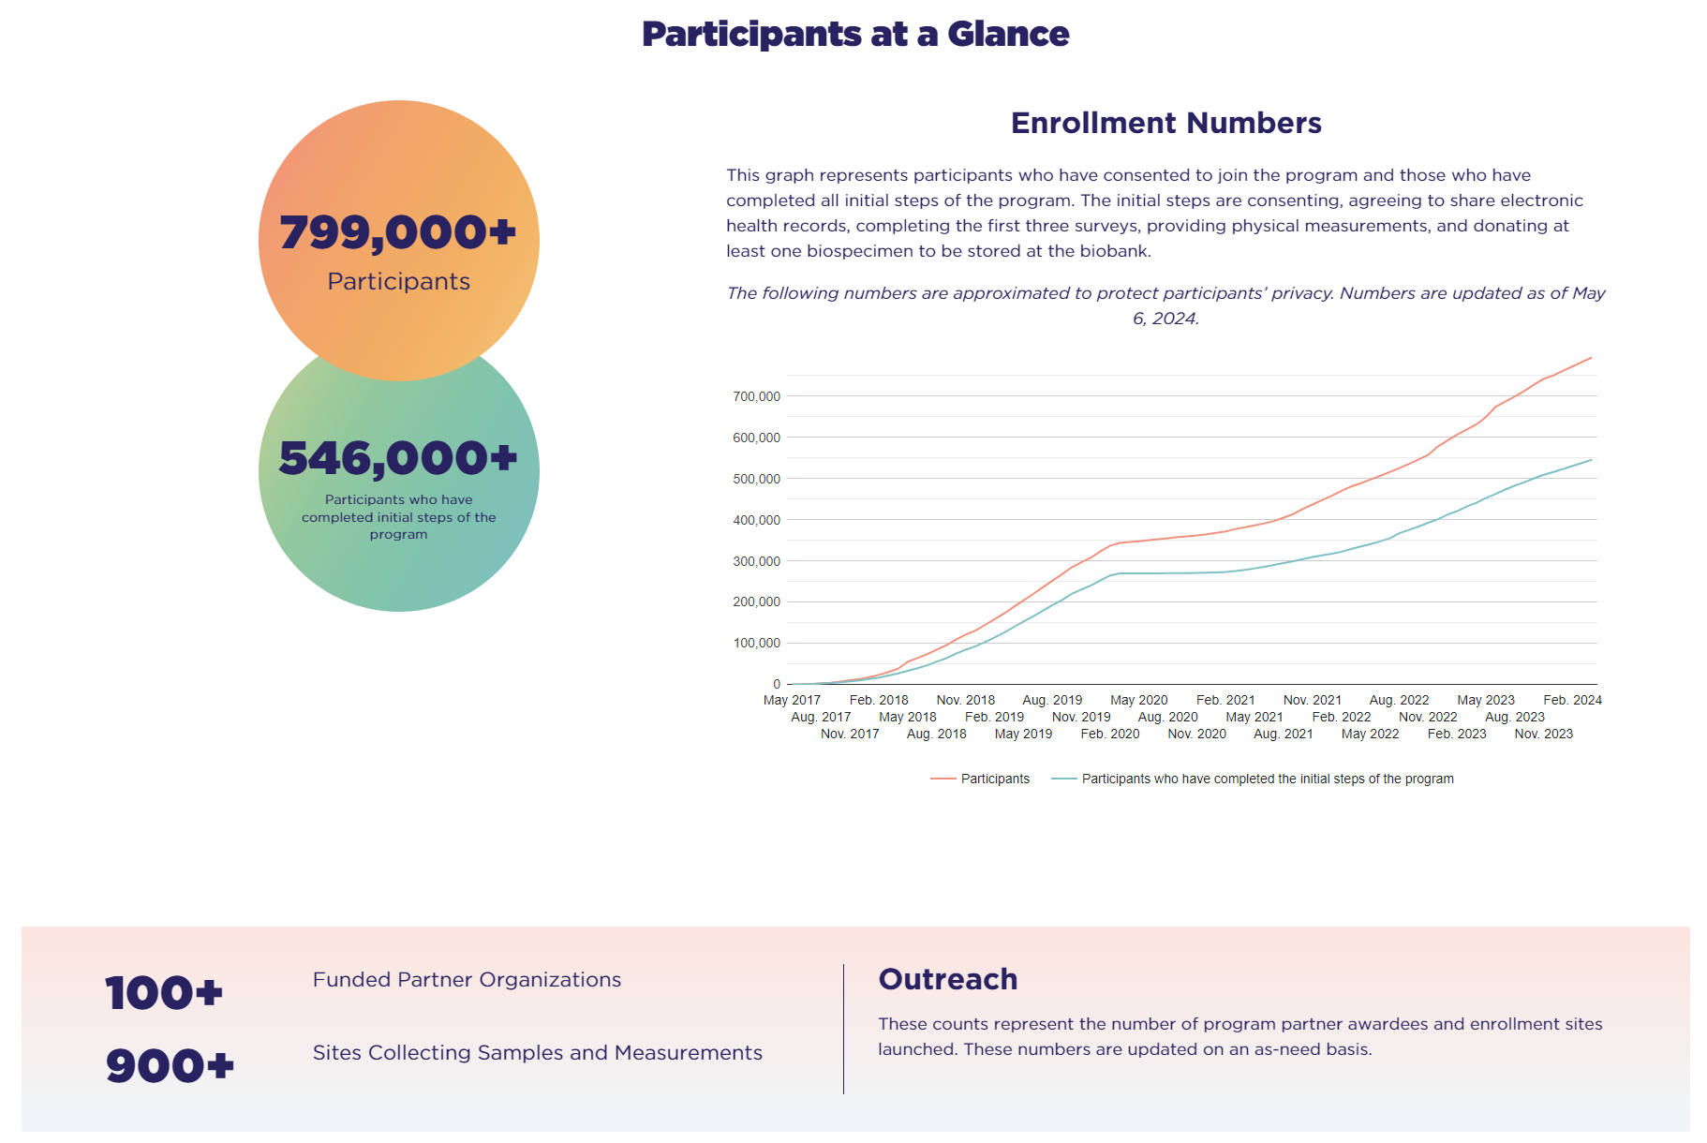
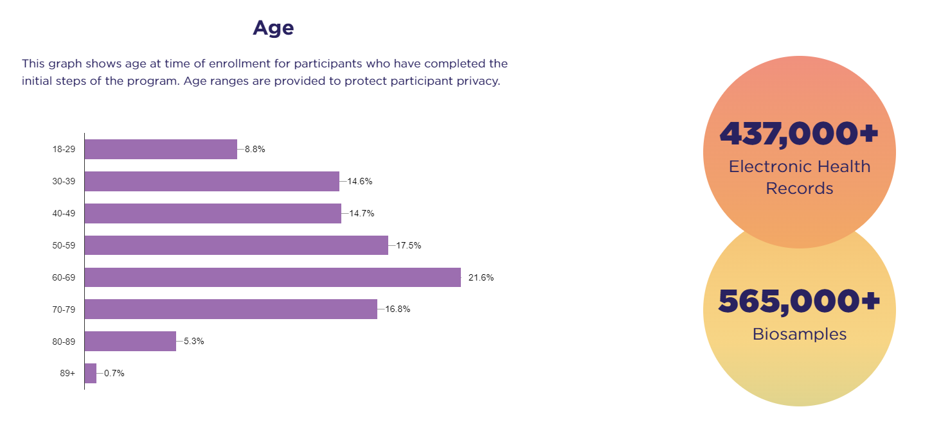
https://www.researchallofus.org/data-tools/data-snapshots/

Slide 22
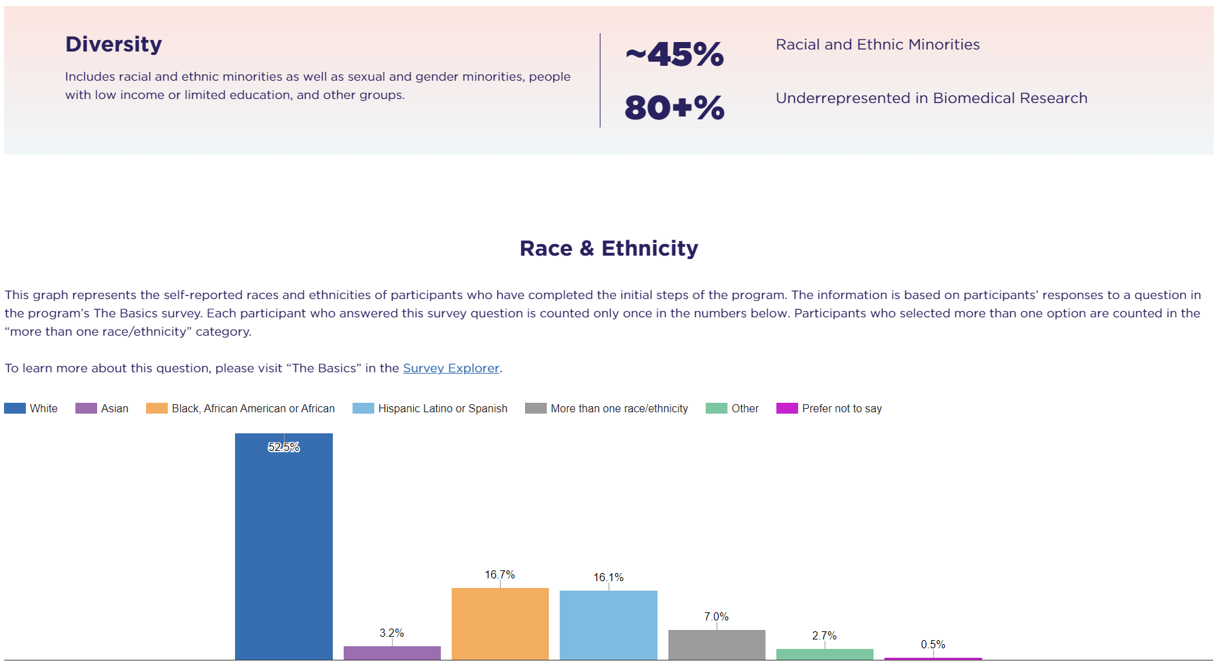
https://www.researchallofus.org/data-tools/data-snapshots/

Slide 23
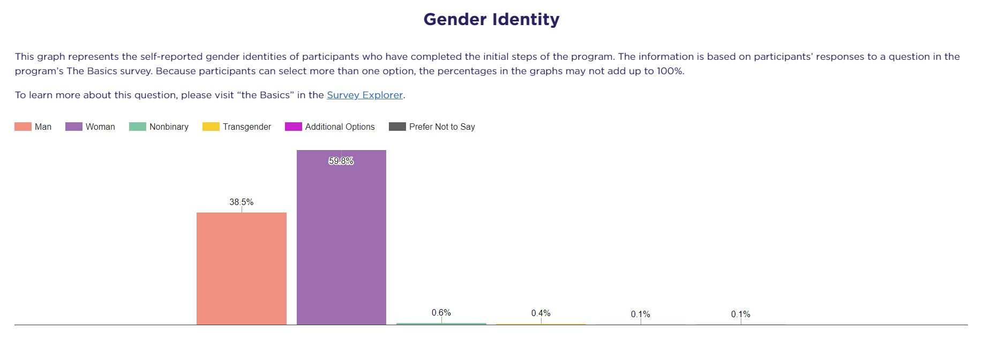
https://www.researchallofus.org/data-tools/data-snapshots/

Slide 24
https://www.researchallofus.org/data-tools/data-snapshots/

Slide 25
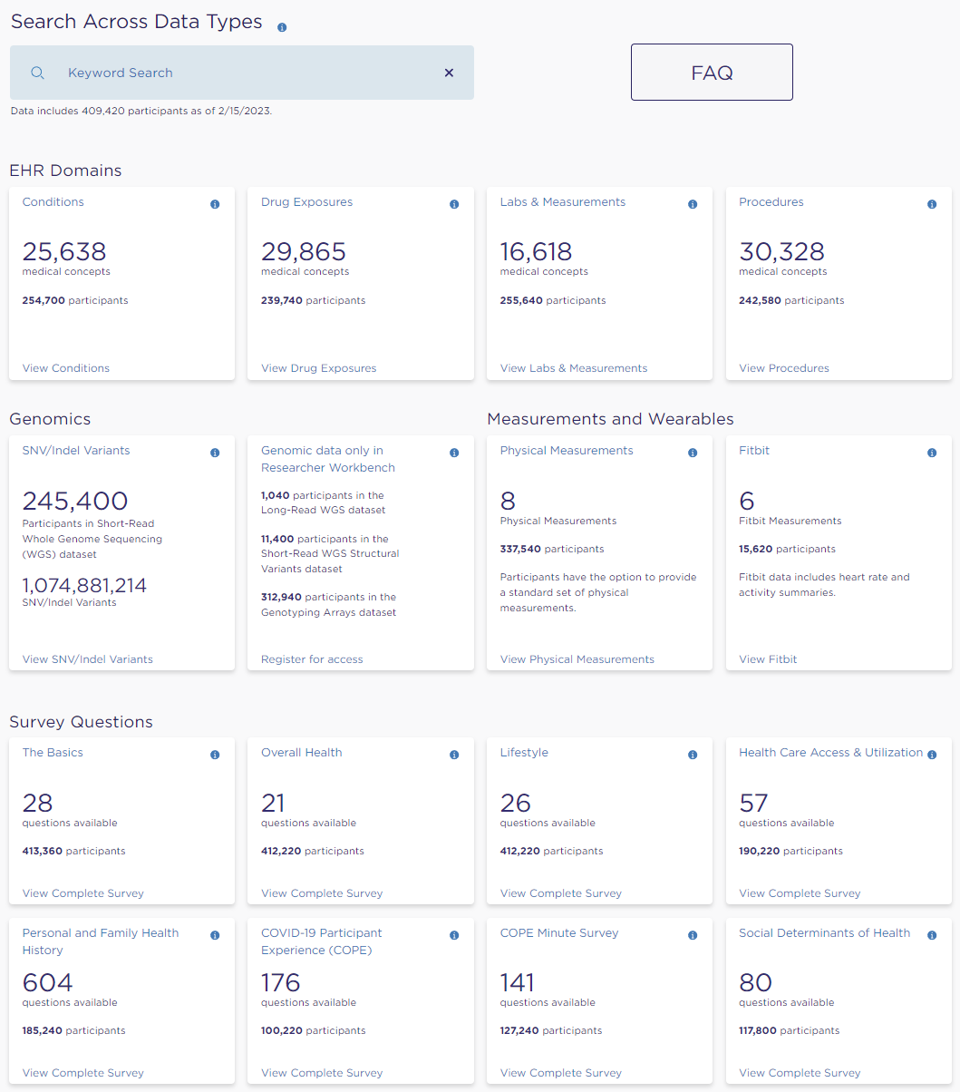
https://databrowser.researchallofus.org/

Slide 26
Using All of Us for health disparities research
Pros (advantages)
Size & diversity of participant cohort
Linkage to electronic health records
Social determinants of health, environmental & genetic data
Cons (disadvantages)
Volunteer participants – not a nationally representative sample
Supports observational studies only
Correlation (association) is not causation!
Reliance on electronic health records

Slide 27
Electronic health records (EHR)
Systematized collection of patient and population electronically stored health information in a digital format
Include a range of data, including demographics, medical history, medication and allergies, immunization status, laboratory test results, radiology images, vital signs, personal statistics like age and weight, and billing information
https://en.wikipedia.org/wiki/Electronic_health_record

Slide 28
International Classification of Diseases (ICD) Codes
Medical classification list of codes for diseases, symptoms, findings, and injuries maintained by the World Health Organization (WHO)
Used by more than 100 countries to track global morbidity and mortality data
Integrated into EHR to record medical findings of patients in a standardized format
ICD-9 and ICD-10 currently used versions
ICD-10-CM extended version used in United States
Used by investigators for healthcare research
Even though not intended for this purpose!

Slide 29
International Classification of Diseases (ICD) Codes
For research purposes, groups of ICD codes are delineated to capture health outcomes of interest
ICD groupings are often created for one or a small set of phenotypes, and typically the groupings are created using domain expertise and consensus
Grouping necessary because ICD codes encode granularity that may not be useful in certain applications
20 ICD-9-CM codes and 113 ICD-10-CM for type 1 diabetes (T1D), including codes for T1D with various complications like ketoacidosis, renal disease, neurological manifestations, etc

Slide 30
Phecodes
Manually curated groups of ICD codes intended to capture clinically meaningful concepts for research
Effort to scale ICD grouping process to include all available ICD diagnosis codes
Created to rapidly characterize a wide swath of diagnoses, symptoms, and findings—a phenome-wide snapshot—needed to conduct phenome-wide association studies (PheWAS)
Study hundreds or thousands of diseases simultaneously
Disease-agnostic approach to health disparities research
Compare the relative effects of different classes of risk factors

Slide 31
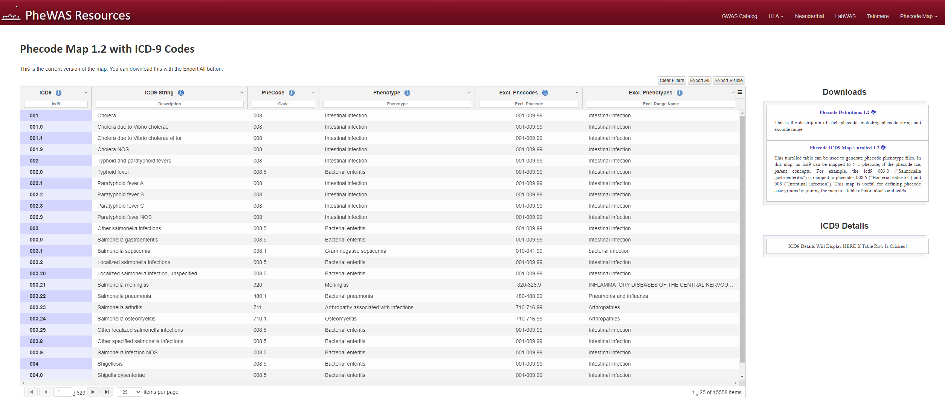
Phecodes maintained by the Center for Precision Medicine at Vanderbilt University Medical Center
https://www.phewascatalog.org/phecodes

Slide 32
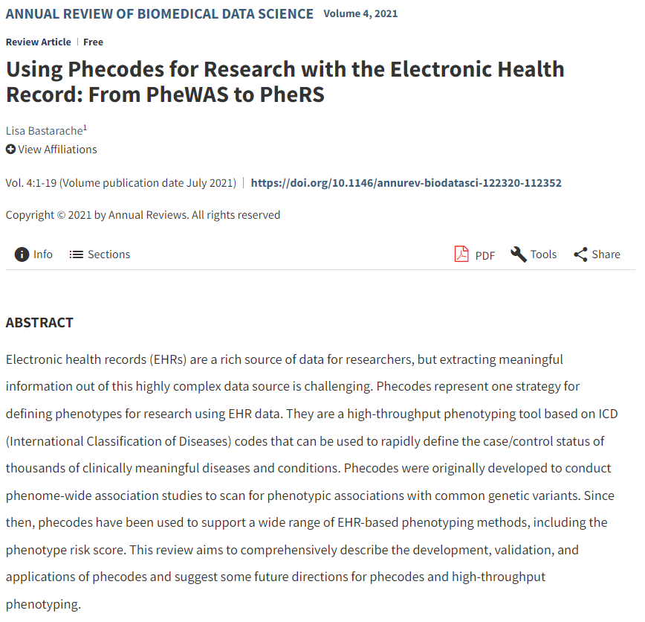

Slide 33
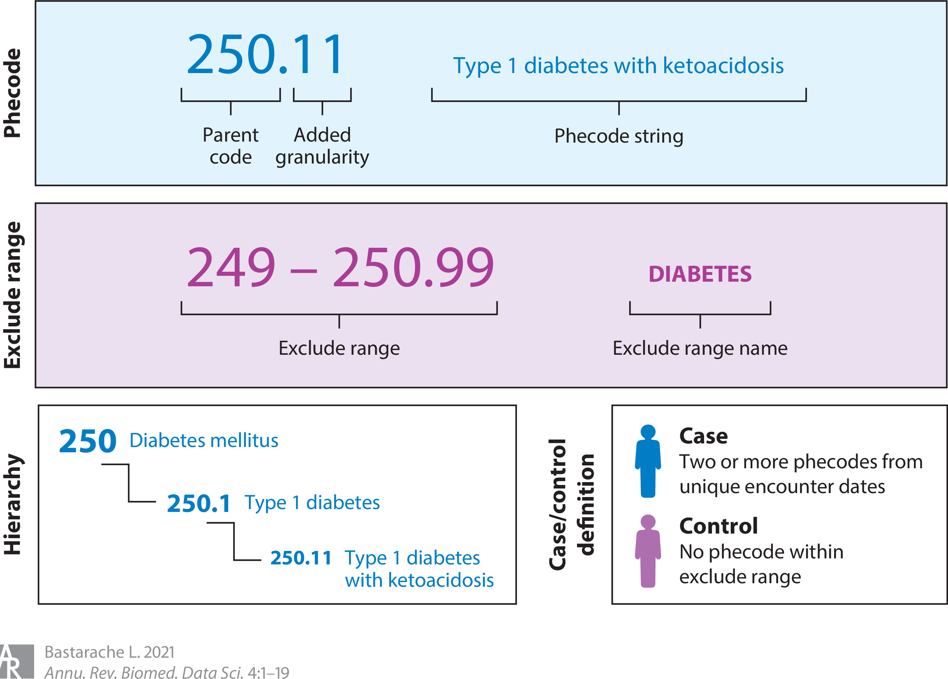

Slide 34
OHSDI, SNOMED, OMOP
OHSDI is a non-profit, global research collaborative that provides open-source solutions and products to enable analysis and sharing of health and observational data
SNOMED CT is a core terminology within OHDSI’s common data model: Observational Medical Outcomes Partnership (OMOP), allowing the use of other terminologies and classifications through computable linkages
Widely used by clinical and research communities, including by All of Us
We use phecodes in light of our focus on genetics (good for case-control cohorts)
https://www.ohdsi.org/snomed-collaboration/

Slide 35
Epidemiology basics

Slide 36
Epidemiology: health disparities research
We conduct health disparities research, using observational studies of population biobanks, in two phases
Discovery
Quantify health disparities as disease prevalence differences between population groups (race & ethnicity)
Characterization
Find risk factors associated with health disparities
Quantify their effects (associations) with health outcomes – multivariable regression
Evaluate the extent to which they explain (mediate) health disparities – mediation analysis

Slide 37
Epidemiology: basic definitions
The study of how often diseases occur in different groups of people and why
Oriented towards groups (populations) rather than individuals (as in clinical findings)
Used to plan and evaluate strategies to prevent illness and as a guide to the management of patients in whom disease has already developed
Employs special techniques of data collection, analysis, and interpretation
https://www.bmj.com/about-bmj/resources-readers/publications/epidemiology-uninitiated

Slide 38
Epidemiology: study populations
A key feature of epidemiology is the measurement of disease outcomes in relation to a population at risk.
Implicit in epidemiological studies is the target population about which conclusions can be drawn, e.g. US population
Only rarely can measurements be made of the full target population
More often observations can only be made on a smaller study sample
https://www.bmj.com/about-bmj/resources-readers/publications/epidemiology-uninitiated

Slide 39
Epidemiology: study populations
To avoid bias and support extrapolation of findings from a study sample to the target population
Study sample should be
Large enough to support statistical inference
Randomly selected subset of target population
Population biobanks, e.g. All of Us, meet the first criteria (large size) but not the second, since they are made up of volunteer participants
Potential bias, which we will cover later in the course
https://www.bmj.com/about-bmj/resources-readers/publications/epidemiology-uninitiated

Slide 40
Epidemiology: morbidity (disease occurrence)
Epidemiology aim – health surveillance, monitor disease in a population
Morbidity & mortality
Morbidity – state of living with disease
Mortality – death, from disease or other causes
Quantifying morbidity – disease prevalence & incidence
For this course, we will quantify morbidity via disease prevalence
Burden – how much (what proportion) of the population is currently living with disease
Calculation – number of disease cases divided by population size
Cross-sectional – slice through the population at a given time
https://www.youtube.com/watch?v=nnPkKFMfZe8

Slide 41
Epidemiology: prevalence vs. incidence
Disease incidence – number of new cases that develop over a time period (usually one year)
Measure of risk – probability of developing disease in a given time period
Measures new events of disease rather than existing cases (as in prevalence)
https://www.youtube.com/watch?v=nnPkKFMfZe8

Slide 42
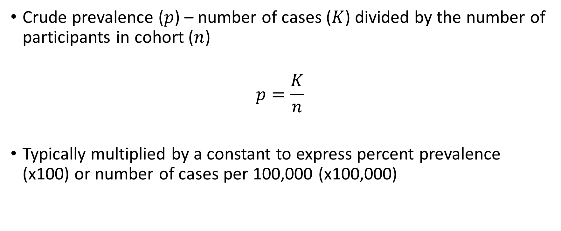
Quantifying disparities – disease prevalence
Crude prevalence ($p$) – number of cases ($K$) divided by the number of participants in cohort ($n$)
$$p=\frac{K}{n}$$
Typically multiplied by a constant to express percent prevalence (x100) or number of cases per 100,000 (x100,000)

Slide 43
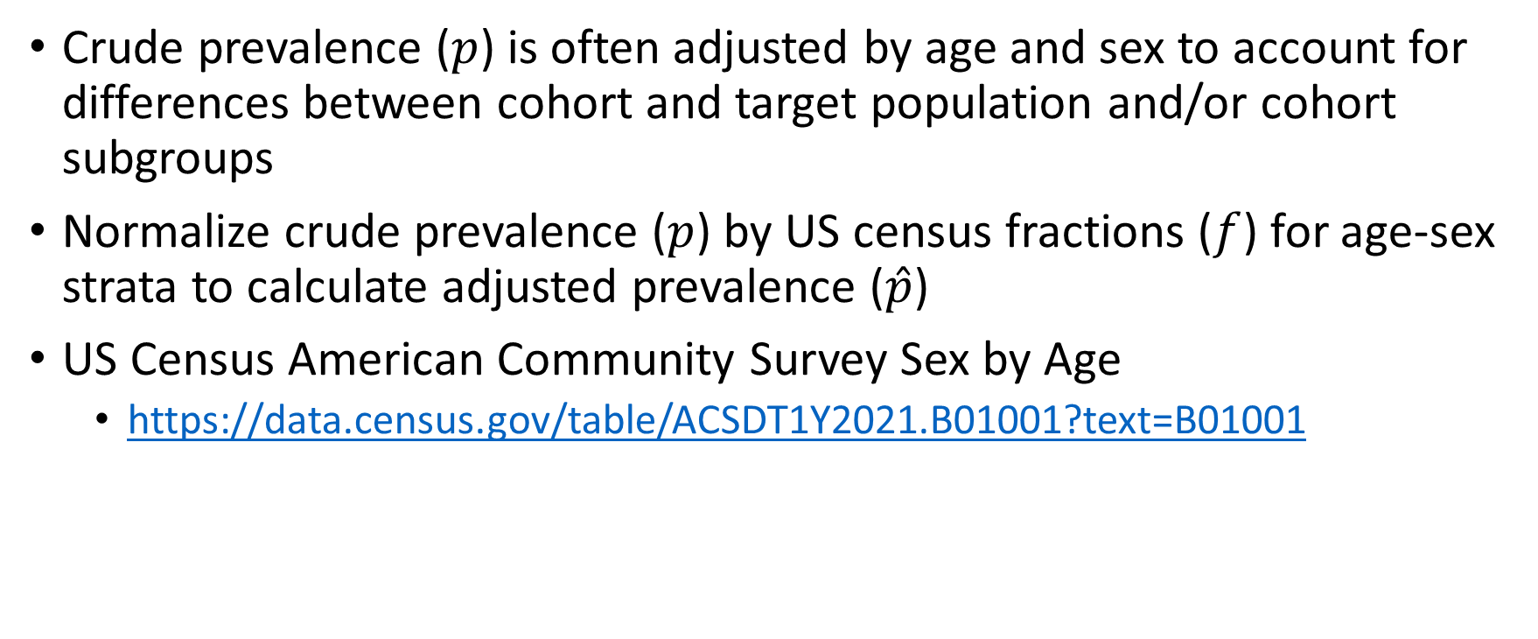
Quantifying disparities – disease prevalence
Crude prevalence ($p$) is often adjusted by age and sex to account for differences between cohort and target population and/or cohort subgroups
Normalize crude prevalence ($p$) by US census fractions ($f$) for age-sex strata to calculate adjusted prevalence ($\hat{p}$)
US Census American Community Survey Sex by Age
https://data.census.gov/table/ACSDT1Y2021.B01001?text=B01001

Slide 44
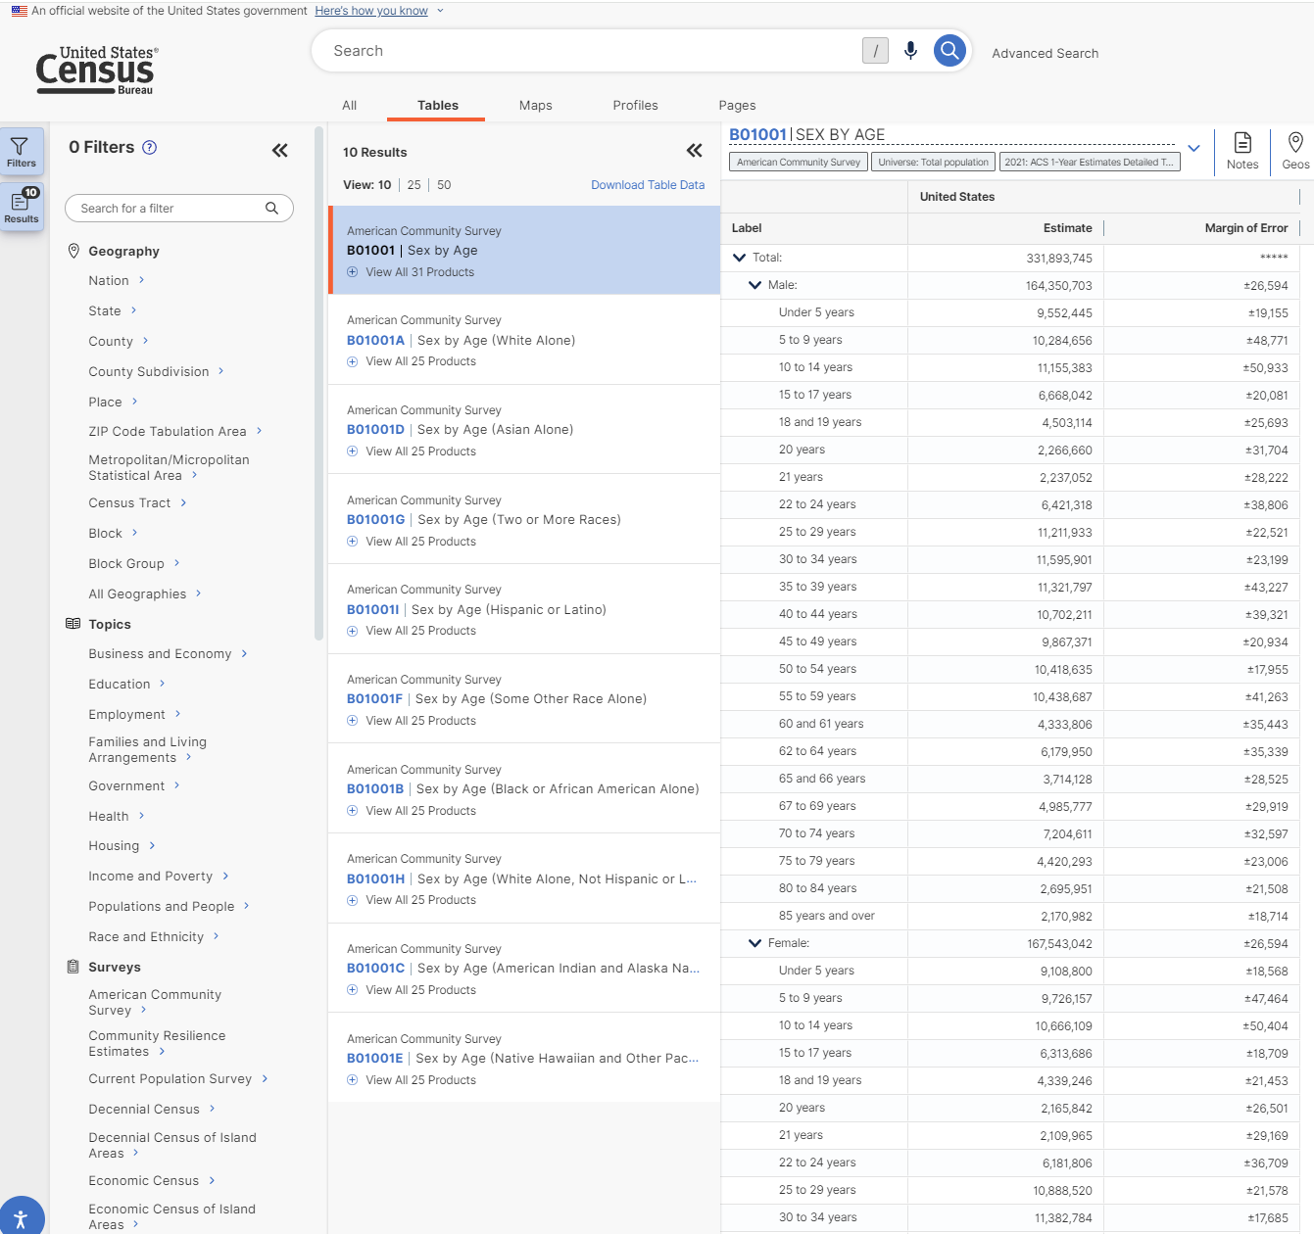
https://data.census.gov/table/ACSDT1Y2021.B01001?text=B01001

Slide 45
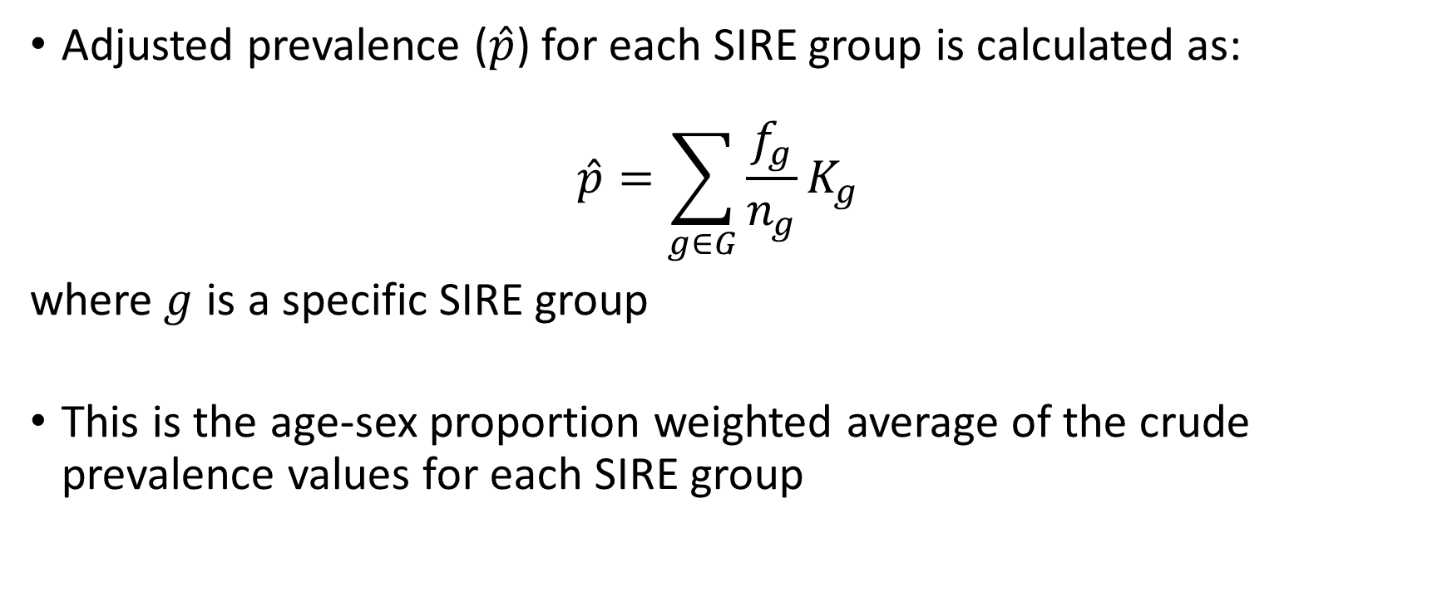
Quantifying disparities – disease prevalence
Adjusted prevalence ($\hat{p}$) for each SIRE group is calculated as: $\hat{p}=\sum_{g∈G}{\frac{f_{g}}{n_{g}}K_{g}}$
where$g$ is a specific SIRE group
This is the age-sex proportion weighted average of the crude prevalence values for each SIRE group

Slide 46
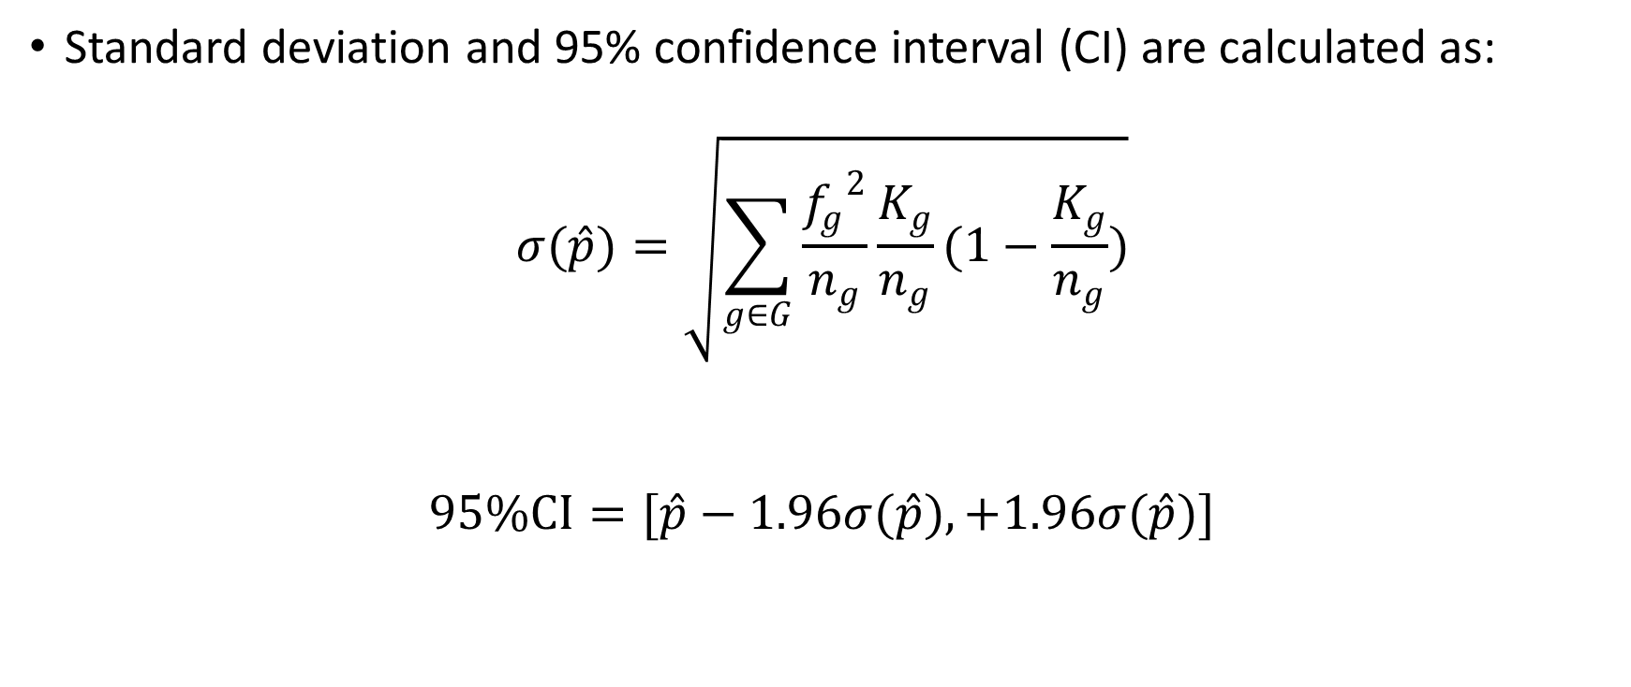
Quantifying disparities – disease prevalence
Standard deviation and 95% confidence interval (CI) are calculated as:
$$σ(\hat{p})=\sqrt{\sum_{g∈G}{\frac{{f_{g}}^{2}}{n_{g}}\frac{K_{g}}{n_{g}}(1−\frac{K_{g}}{n_{g}})}}$$
$$95\%CI=[\hat{p}−1.96σ(\hat{p}), +1.96σ(\hat{p})]$$

Slide 47
Examples

Slide 48
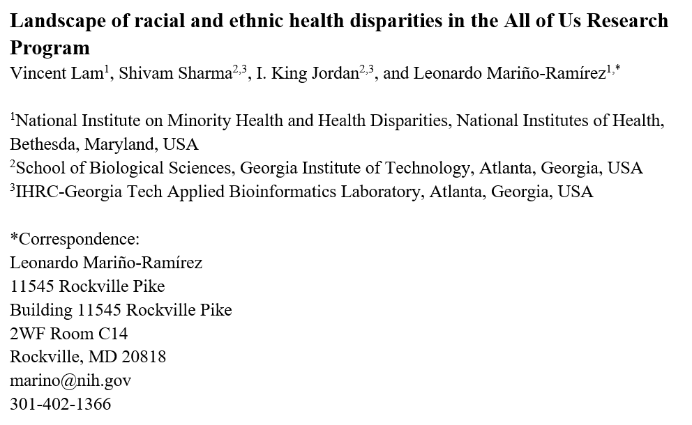
*under revision at Database

Slide 49
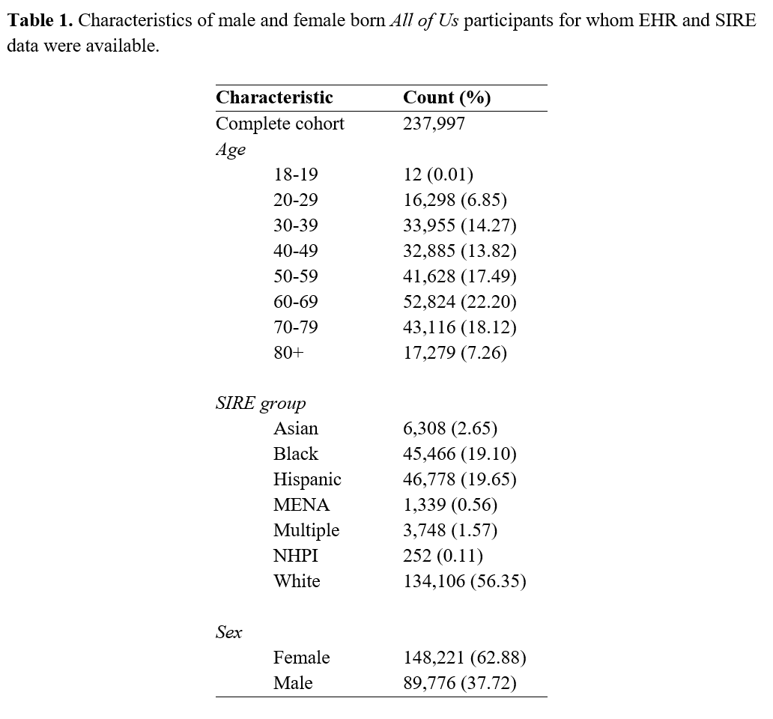

Slide 50
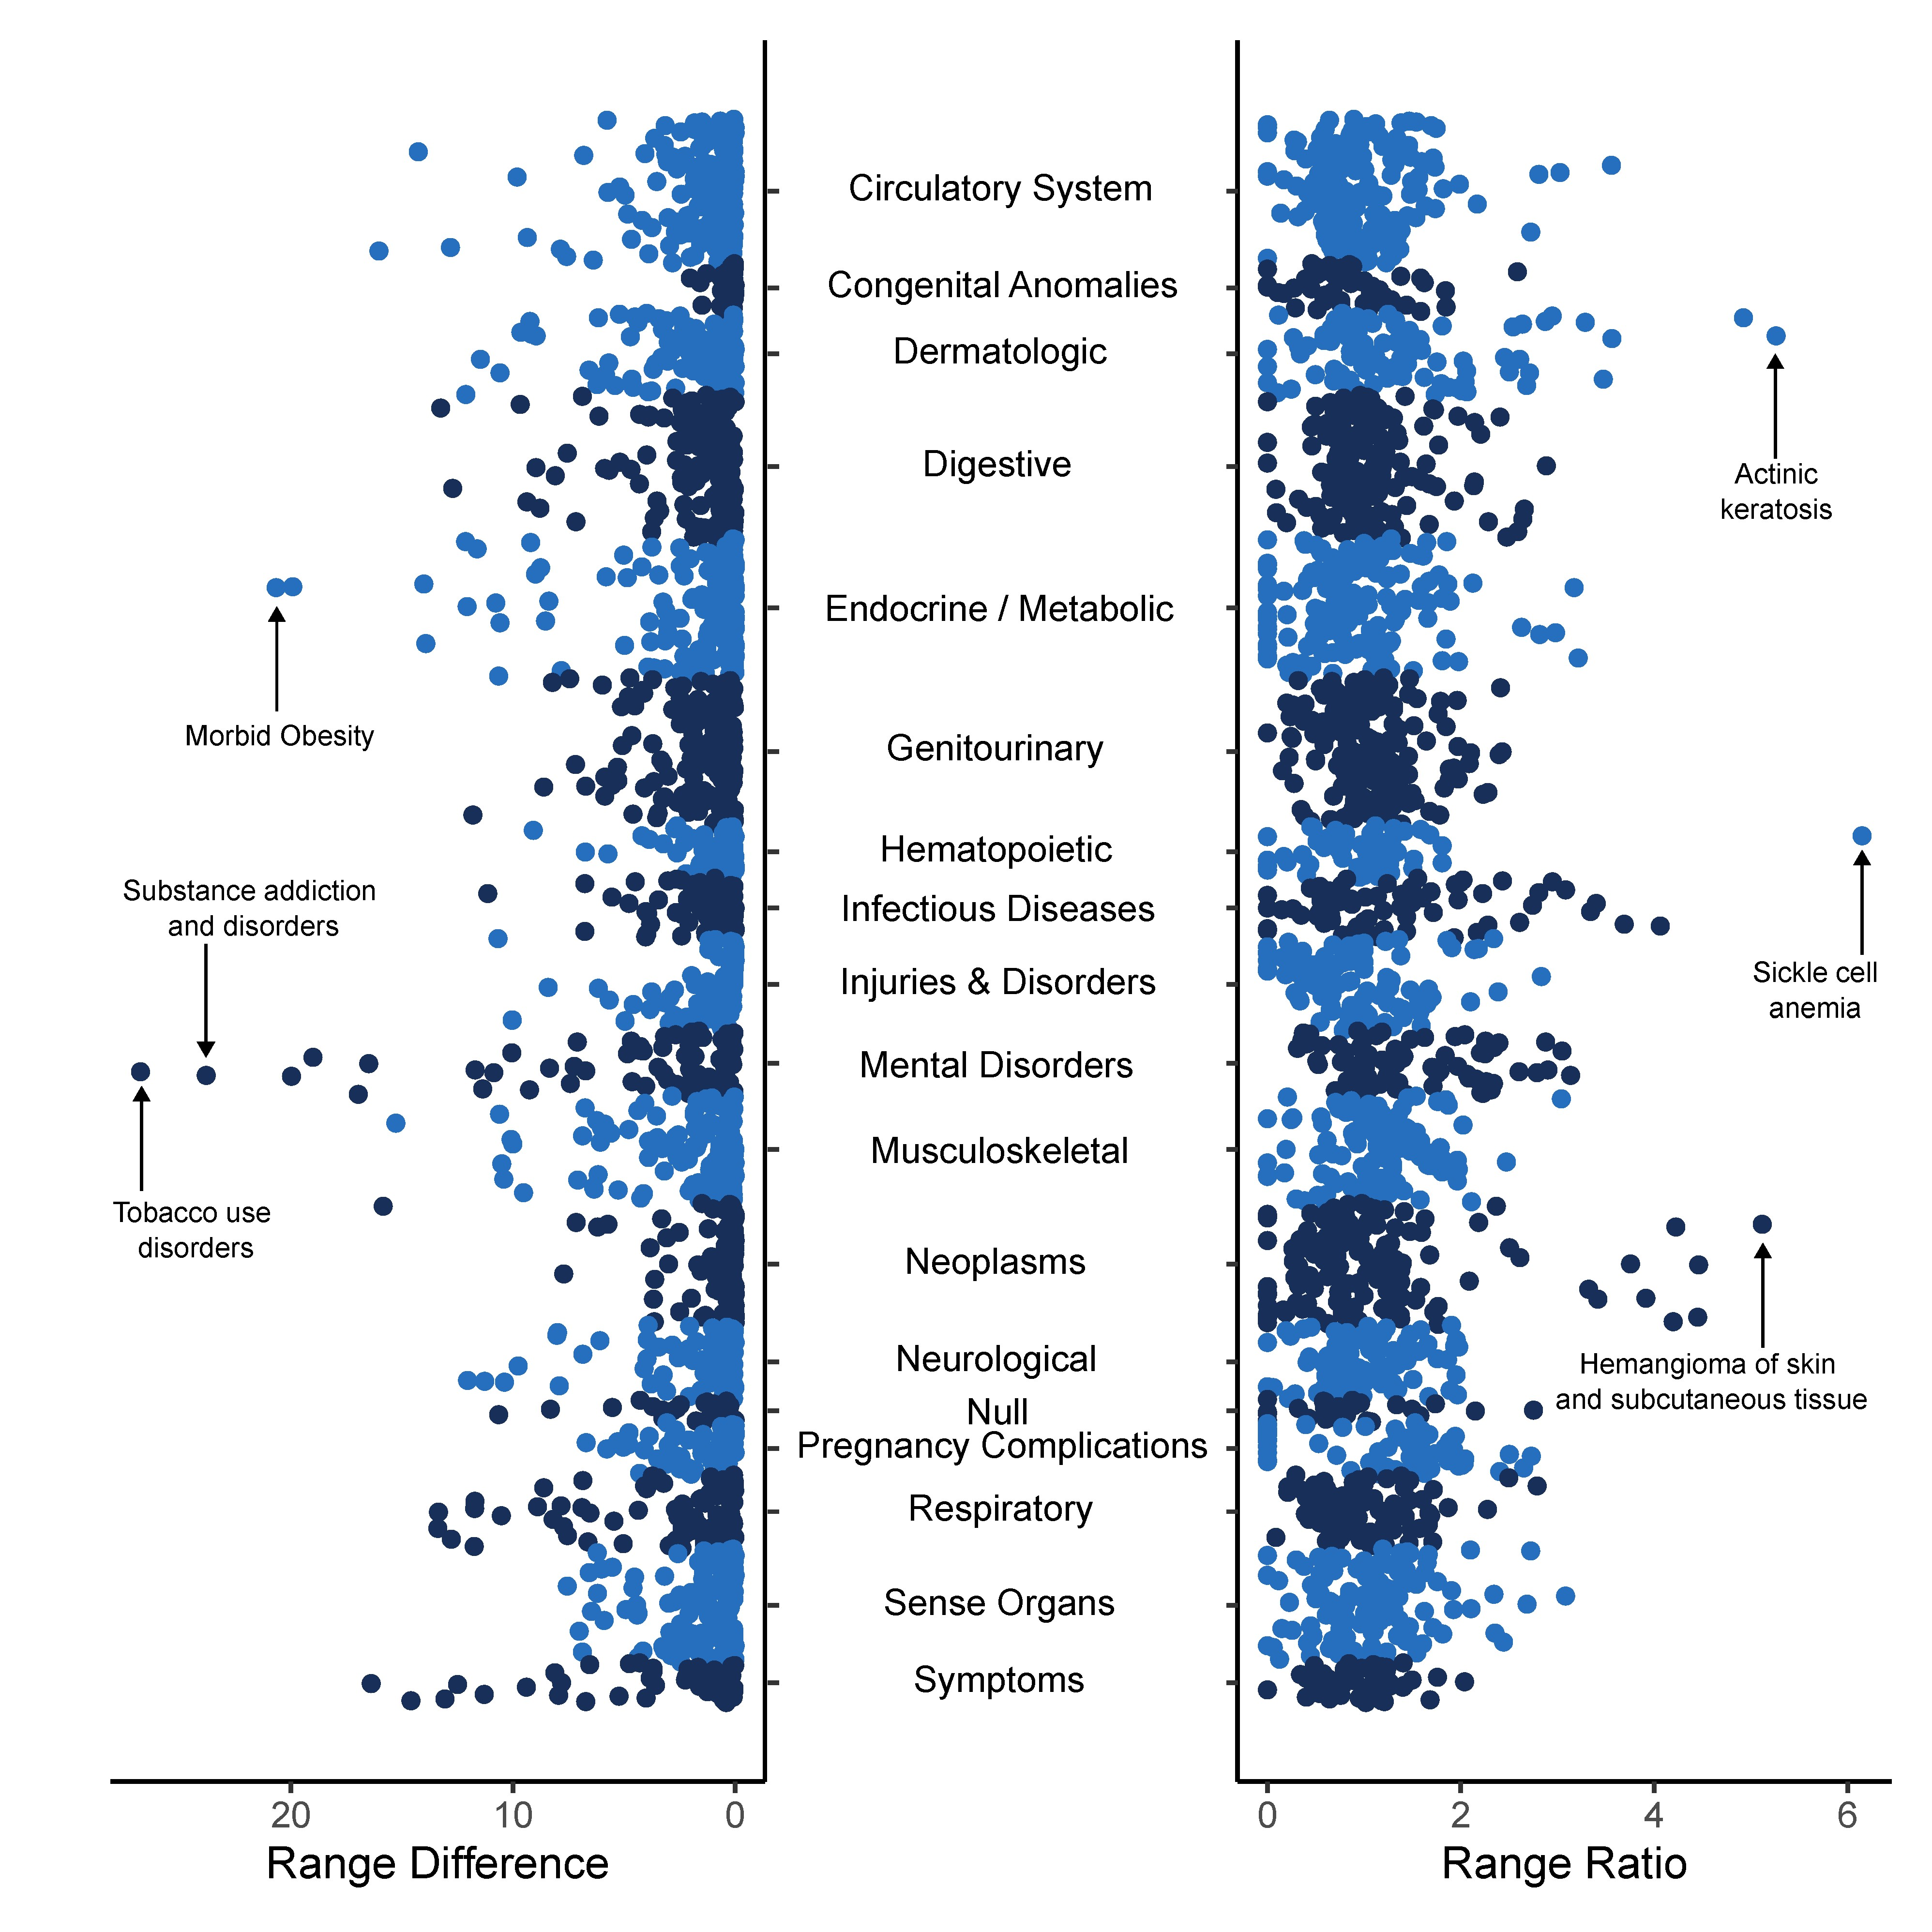
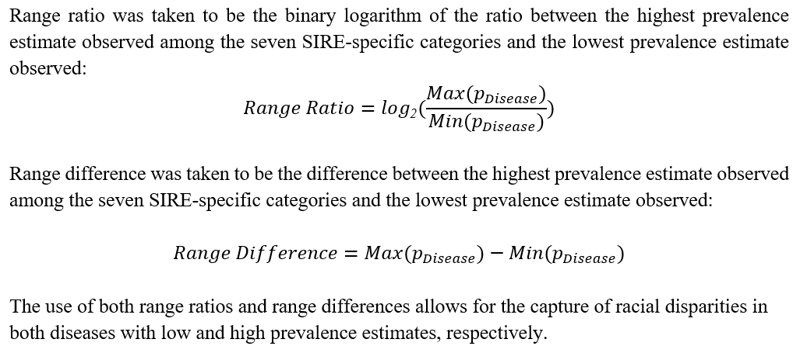

Slide 51
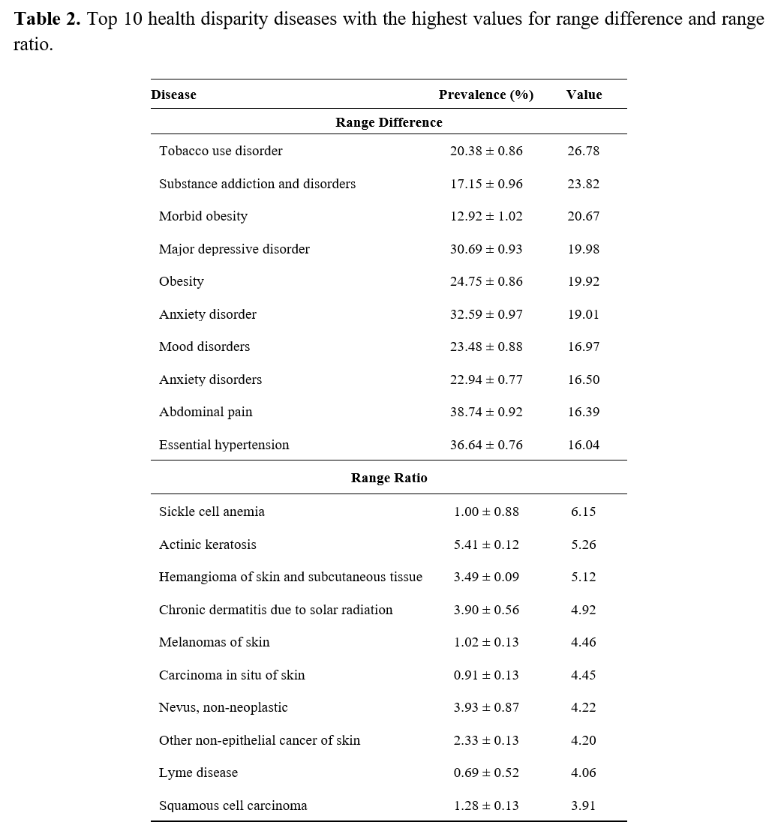

Slide 52
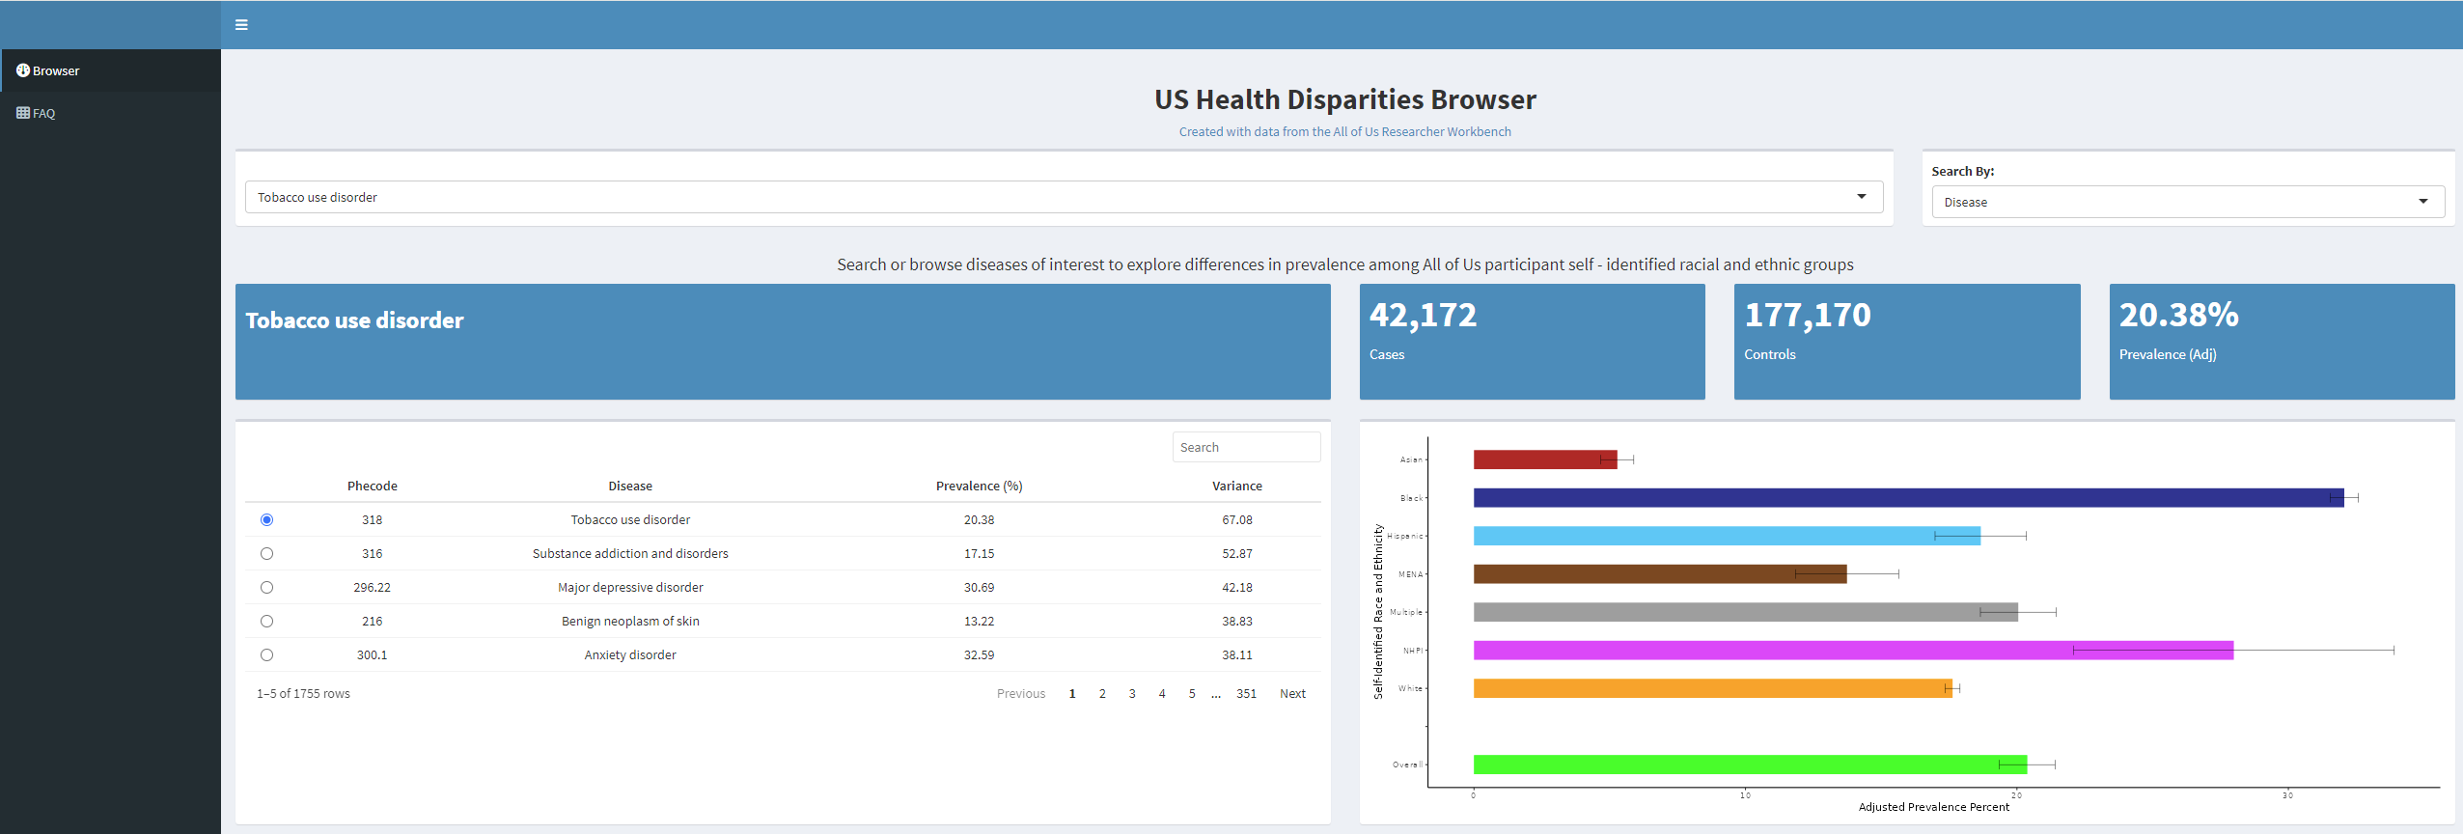
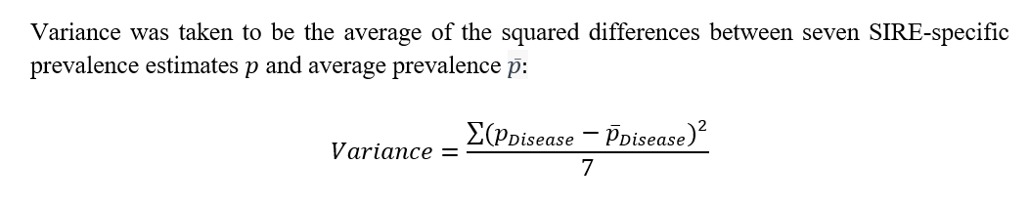
https://usdisparities.biosci.gatech.edu/

Slide 53
Conclusions & limitations
Overview of health disparities in the All of Us cohort
Interactive web browser serves as a resource for researchers interested in leveraging the All of Us platform
Limitation: potential sampling bias owing to All of Us volunteer participants
Limitation: disease prevalence estimates rely on electronic health record data (EHR)

Slide 54
Questions for the practical lab session
How are age- and sex-adjusted disease prevalence values calculated for different race & ethnicity groups using biobank data?
Demographic data – race or ethnicity, age, sex
Disease diagnosis data – ICD codes and phecodes
How are age- and sex-adjusted disease prevalence values for different race & ethnicity groups visualized?

Slide 55
Ethics

Slide 56
Ethics of minority health and health disparities research
Reasons to be careful, thoughtful, and sensitive:
Focus on socially disadvantaged minority groups
Focus on group differences
Socially defined race and ethnicity groups
Differ with respect to their social environment (social determinants of health)
Differ with respect to their genetic background
Challenge: teasing these apart with observational studies (confounding)

Slide 57
Ethics of minority health and health disparities research
Group differences and the potential for stigmatization
All of Us defines stigmatizing research as “any research proposal, project, or question that has the potential to instigate or promote marginalization of, discrimination against, or loss of status by a person or group of people”
May result from research design or findings
May be intentional or unintentional
https://www.researchallofus.org/faq/policy-on-stigmatizing-research/

Slide 58
Ethics of minority health and health disparities research
The first step in health disparities research is quantifying group differences in health outcomes (i.e. disease prevalence)
Defining group differences in this way is not inherently stigmatizing
Rather, it is a crucial first step in achieving health equity
Should promote empathy and understanding for marginalized groups
If all group differences are defined as stigmatizing, would have a chilling effect on health disparities research
Ignoring or obscuring group differences, however well-intentioned, will do more harm than good

Slide 59
Ethics of minority health and health disparities research
Difference (diversity) does not in any way imply a hierarchy of value
Different does not mean better (superior) or worse (inferior)
Differences do not imply anything about human moral worth or universal human dignity
Differences are empirical observations, whereas human dignity is a moral principle

Slide 60

We wish to emphasize that equality of opportunity and equality in law in no way depend, as ethical principles, upon the assertion that human beings are in fact equal in endowment.
UNESCO statement on the nature of race and race differences | 1951

Slide 61
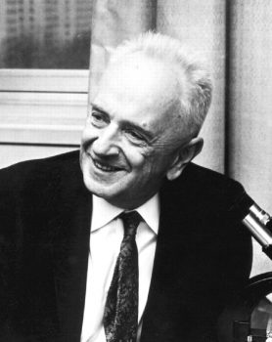
Equality is confused with identity, and diversity with inequality … Political propagandists, of both the extreme right and left, spread the confusion deliberately.
Diversity is an observable fact of nature, while equality is an ethical commandment.
Genetic Diversity & Human Equality | 1973
Theodosius Dobzhansky

Slide 62
